Slide 1
Course Code: CSC306/ CSE211 Course Title: Algorithms Group: 9
Rudrita Rahman (2021059; Section: 1)
Fabiha Rahman (2031045; Section: 3)
Fariza Rahman (2031046; Section: 3)

Slide 2
Heap Sort
Heap Sort was invented by J. W. J. Williams in 1964. This sorting algorithm can be thought of as an improved selection sort. It is a classic sorting in-place algorithm and can be considered as a combination of Tournament Sort and Tree Sort. As it is a comparison-based sorting algorithm so that it best used for sorting a huge list of elements and find minimum and maximum element easily. The most complex part of heap sort is correctness. The paradigm of this algorithm is Brute Force algorithm. Heap sort algorithm can be divided into two parts. 1. In the fist step need to built a heap out of the data. 2. And then in the second step, a sorted array is created by repeatedly extracting the maximum element from the heap (the root of the heap) and inserting it into the array.
Notes:
According to research paper, SETHEAP → Arranges n elements as a heap INHEAP → Adds a new element to an existing heap; resembles Tree Sort in being bottom to top method OUTHEAP → Extracts the last element from a heap SHOWHEAP → Effectively the result of INHEAP followed by OUTHEAP. Essentially the same as the Tournament Sort; which is a top to bottom method, but it uses an improved storage allocation and initialization.

Slide 3
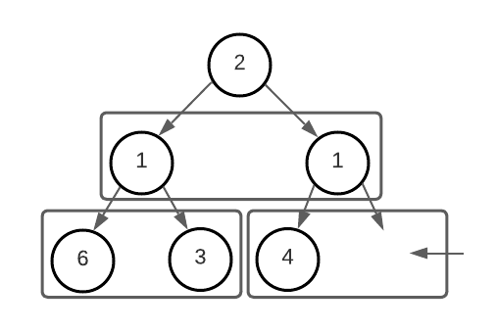
Binary Heap Data Structure
Array based data structure; nearly complete binary tree (left to right)
Each level of the tree need to remain filled, however, exceptional for the last level; no order break; elements must fill left to right
An array A that represents a heap is an object with two attributes:
A.length, which (as usual) gives the number of elements in the array;
A.heap-size, which represents how many elements in the heap are stored within array A.
Nearly filled

Slide 4
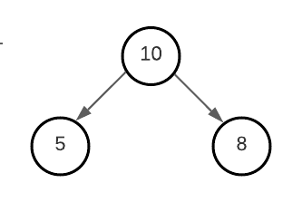
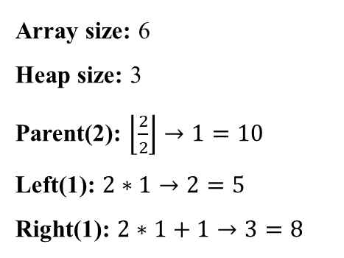
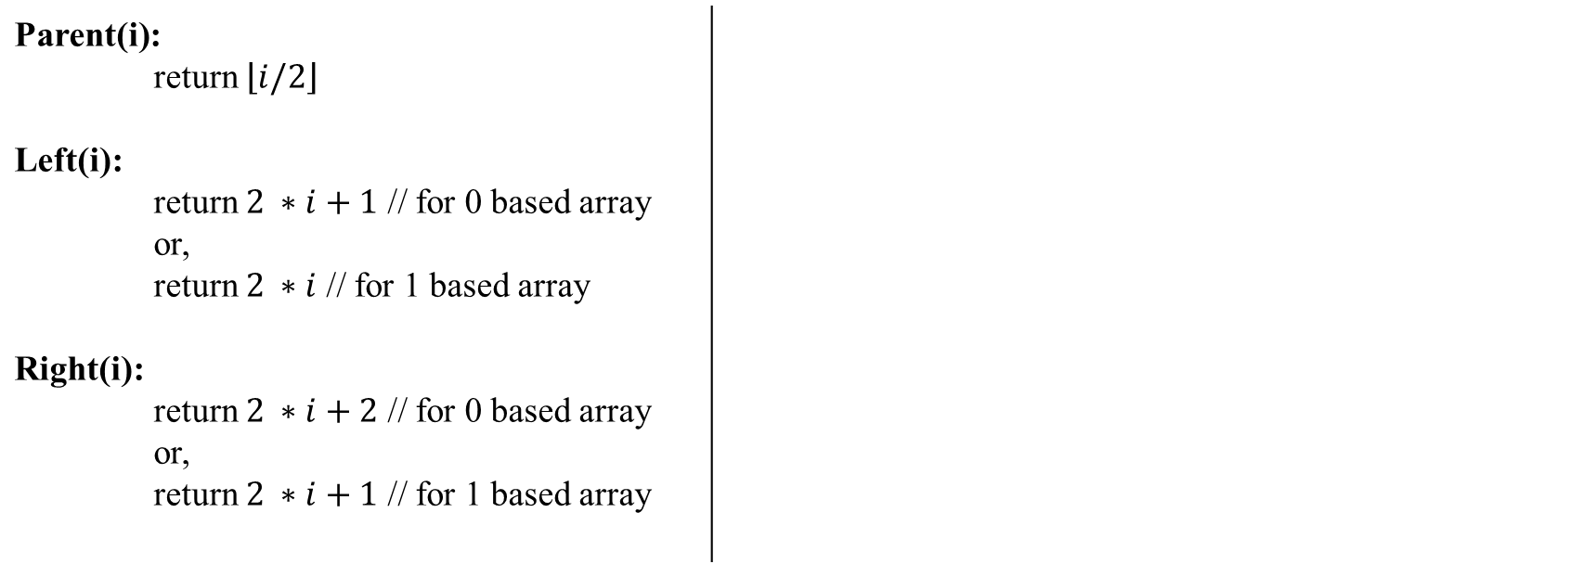
Root, Left & Right Pseudocode
Parent(i): return $\left\lfloor i/2\right\rfloor$ Left(i): return $2 ∗i+1$ // for 0 based array or, return $2 ∗i$ // for 1 based array Right(i): return $2 ∗i+2$ // for 0 based array or, return $2 ∗i+1$ // for 1 based array
10 | 5 | 8 | 3 | 2 | 9
i | 1 | 2 | 3 | 4 | 5 | 6
Array size: 6
Heap size: 3
Parent(2): $\left\lfloor \frac{2}{2}\right\rfloor →1=10$
Left(1): $2∗1→2=5$
Right(1): $2∗1+1→3=8$
1
2
3

Slide 5
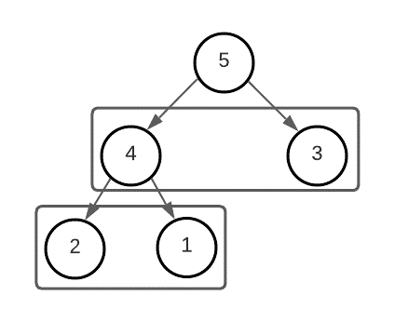
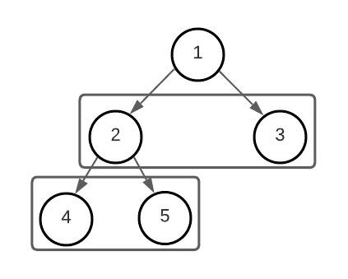
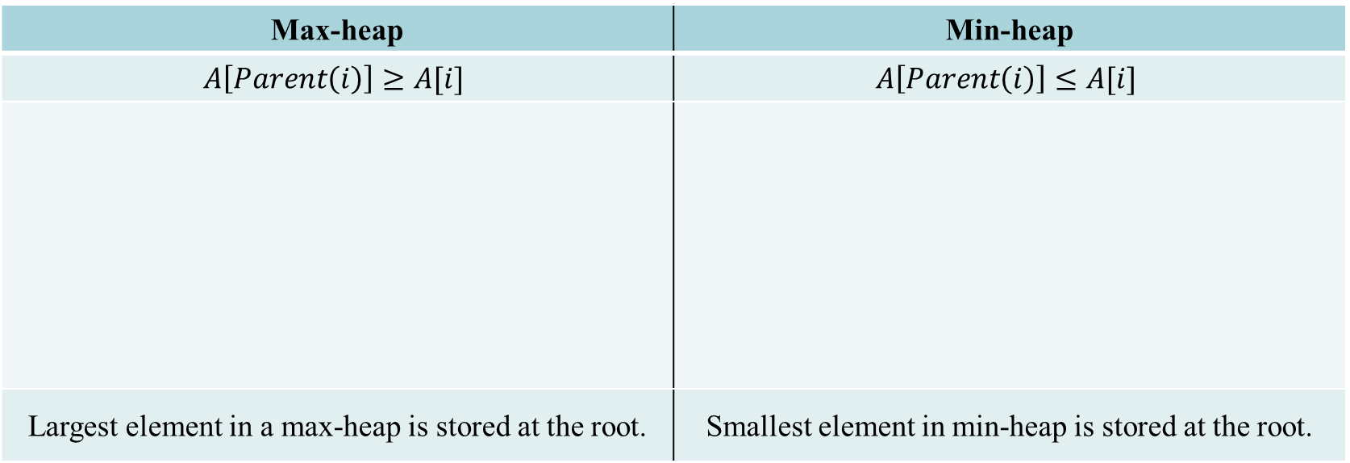
Types of Binary Heaps
Max-heap | Min-heap
$$A\left[Parent\left(i\right)\right]≥A[i]$$ | $$A\left[Parent\left(i\right)\right]≤A[i]$$
Largest element in a max-heap is stored at the root. | Smallest element in min-heap is stored at the root.
There are two types of binary heaps.

Slide 6
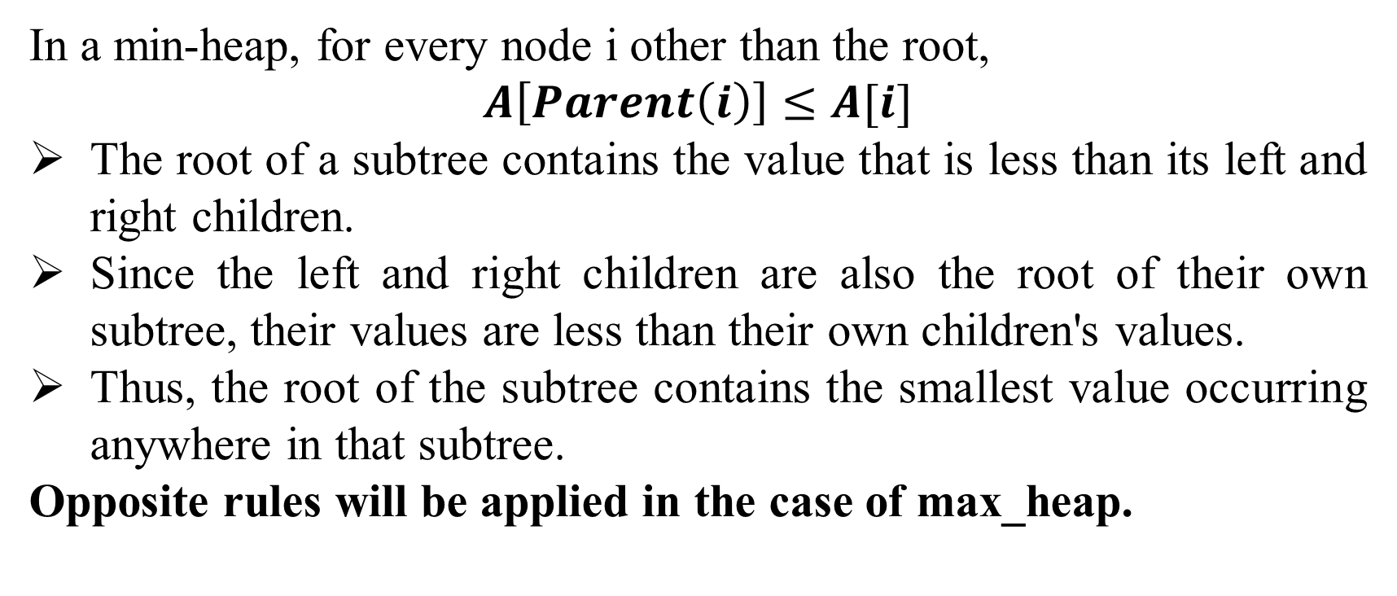
Maintaining the Heap Property
In a min-heap, for every node i other than the root,
$A\left[Parent\left(i\right)\right]≤A[i]$
The root of a subtree contains the value that is less than its left and right children.
Since the left and right children are also the root of their own subtree, their values are less than their own children's values.
Thus, the root of the subtree contains the smallest value occurring anywhere in that subtree.
Opposite rules will be applied in the case of max_heap.
Notes:
Md. Asif Bin Khaled, Maintaining the Heap Property, https://docs.google.com/presentation/d/1ZGiEK5zT_0vbUznwuQEos70I2EKArLgK/edit#slide=id.p8

Slide 7
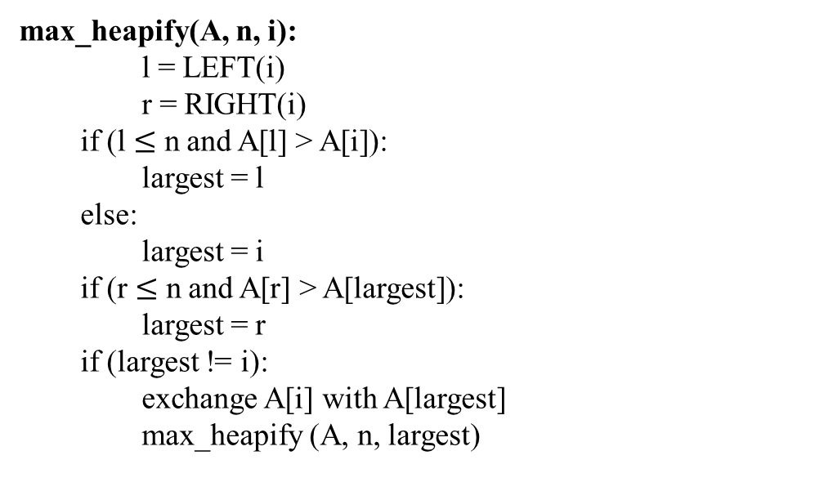
Max Heapify Pseudocode
max_heapify(A, n, i):
l = LEFT(i)
r = RIGHT(i)
if (l $≤$ n and A[l] > A[i]):
largest = l
else:
largest = i
if (r $≤$ n and A[r] > A[largest]):
largest = r
if (largest != i):
exchange A[i] with A[largest]
max_heapify (A, n, largest)
Notes:
Md. Asif Bin Khaled, Max Heapify Pseudocode, https://docs.google.com/presentation/d/1ZGiEK5zT_0vbUznwuQEos70I2EKArLgK/edit#slide=id.p9

Slide 8
Simulation of Max Heapify
1
27
2
3
17
3
4
5
6
7
16
13
10
1
8
9
10
11
12
13
14
5
7
12
14
8
9
0
No. of nodes: 14

Slide 9
Simulation of Max Heapify
1
27
2
3
17
3
4
5
6
7
16
13
10
1
8
9
10
11
12
13
14
5
7
12
14
8
9
0
No. of nodes: 14

Slide 10
Simulation of Max Heapify
1
27
2
3
17
10
4
5
6
7
16
13
3
1
8
9
10
11
12
13
14
5
7
12
14
8
9
0
No. of nodes: 14

Slide 11
Simulation of Max Heapify
1
27
2
3
17
10
4
5
6
7
16
13
9
1
8
9
10
11
12
13
14
5
7
12
14
8
3
0
No. of nodes: 14

Slide 12
Building a Heap
We can use the procedure max_heapify in a bottom-up manner to convert an array A[1...n] where n = A.length, into a max-heap.
The elements in the subarray A[(⌊n/2⌋ + 1...n] are all leaves of the tree, and so each is a 1-element heap to begin with.
The procedure build_maxHeap goes through the remaining nodes of the tree and runs max_heapify on each one.
Notes:
Md. Asif Bin Khaled, Building a Heap, https://docs.google.com/presentation/d/1ZGiEK5zT_0vbUznwuQEos70I2EKArLgK/edit#slide=id.p18

Slide 13
Building Max Heap Pseudocode
build_maxHeap(A, n):
A.heap_size = n
for i = ⌊n/2⌋ downto 1:
max_heapify(A, n, i)
Notes:
Md. Asif Bin Khaled, Building Max Heap Pseudocode, https://docs.google.com/presentation/d/1ZGiEK5zT_0vbUznwuQEos70I2EKArLgK/edit#slide=id.p19

Slide 14
Simulation of Build Max Heap Continued
1
5
2
3
3
17
4
5
6
7
10
85
19
6
8
9
22
9
No. of nodes: 9 No. of leaf nodes: $\left\lfloor \frac{n}{2}\right\rfloor =\left\lfloor \frac{9}{2}\right\rfloor =4$

Slide 15
Simulation of Build Max Heap Continued
1
5
2
3
3
17
4
5
6
7
10
85
19
6
8
9
22
9
No. of nodes: 9 No. of leaf nodes: $\left\lfloor \frac{n}{2}\right\rfloor =\left\lfloor \frac{9}{2}\right\rfloor =4$

Slide 16
Simulation of Build Max Heap Continued
1
5
2
3
3
17
4
5
6
7
22
85
19
6
8
9
10
9
No. of nodes: 9 No. of leaf nodes: $\left\lfloor \frac{n}{2}\right\rfloor =\left\lfloor \frac{9}{2}\right\rfloor =4$

Slide 17
Simulation of Build Max Heap Continued
1
5
2
3
3
17
4
5
6
7
22
85
19
6
8
9
10
9
No. of nodes: 9 No. of leaf nodes: $\left\lfloor \frac{n}{2}\right\rfloor =\left\lfloor \frac{9}{2}\right\rfloor =4$

Slide 18
Simulation of Build Max Heap Continued
1
5
2
3
3
19
4
5
6
7
22
85
17
6
8
9
10
9
No. of nodes: 9 No. of leaf nodes: $\left\lfloor \frac{n}{2}\right\rfloor =\left\lfloor \frac{9}{2}\right\rfloor =4$

Slide 19
Simulation of Build Max Heap Continued
1
5
2
3
3
19
4
5
6
7
22
85
17
6
8
9
10
9
No. of nodes: 9 No. of leaf nodes: $\left\lfloor \frac{n}{2}\right\rfloor =\left\lfloor \frac{9}{2}\right\rfloor =4$

Slide 20
Simulation of Build Max Heap Continued
1
5
2
3
85
19
4
5
6
7
22
3
17
6
8
9
10
9
No. of nodes: 9 No. of leaf nodes: $\left\lfloor \frac{n}{2}\right\rfloor =\left\lfloor \frac{9}{2}\right\rfloor =4$

Slide 21
Simulation of Build Max Heap Continued
1
5
2
3
85
19
4
5
6
7
22
3
17
6
8
9
10
9
No. of nodes: 9 No. of leaf nodes: $\left\lfloor \frac{n}{2}\right\rfloor =\left\lfloor \frac{9}{2}\right\rfloor =4$

Slide 22
Simulation of Build Max Heap Continued
1
85
2
3
5
19
4
5
6
7
22
3
17
6
8
9
10
9
No. of nodes: 9 No. of leaf nodes: $\left\lfloor \frac{n}{2}\right\rfloor =\left\lfloor \frac{9}{2}\right\rfloor =4$

Slide 23
Simulation of Build Max Heap Continued
1
85
2
3
22
19
4
5
6
7
5
3
17
6
8
9
10
9
No. of nodes: 9 No. of leaf nodes: $\left\lfloor \frac{n}{2}\right\rfloor =\left\lfloor \frac{9}{2}\right\rfloor =4$

Slide 24
Simulation of Build Max Heap Continued
1
85
2
3
22
19
4
5
6
7
10
3
17
6
8
9
5
9
No. of nodes: 9 No. of leaf nodes: $\left\lfloor \frac{n}{2}\right\rfloor =\left\lfloor \frac{9}{2}\right\rfloor =4$

Slide 25
Heap Sort
At first by using build_maxheap, build a max-heap on the input array A[1...n], where n = A.length.
At the root A[1], the maximum element of the array (A) is stored. To put it into its correct final position have to exchange it with A[n].
Now let’s remove node n from the heap. Decrement A.heap_size to remove element. The children of the root remain max-heaps, but the new root element might violate the max-heap property.
To fix the max-heap property do Max_Heapify(A, 1), which leaves a max-heap in A[1...n-1].
The heapsort algorithm then repeats this process for the max-heap of size n-1 down to a heap of size 2.
Notes:
Md. Asif Bin Khaled, Building Max Heap Pseudocode, https://docs.google.com/presentation/d/1ZGiEK5zT_0vbUznwuQEos70I2EKArLgK/edit#slide=id.p47

Slide 26
Heap Sort Pseudocode
heap_sort(A, n):
build_maxHeap(A, n)
for i = n downto 2:
exchange A[1] with A[i]
A.heap_size = A.heap_size - 1
max_heapify(A, i, 1)
Notes:
Md. Asif Bin Khaled, Heap Sort Pseudocode, https://docs.google.com/presentation/d/1ZGiEK5zT_0vbUznwuQEos70I2EKArLgK/edit#slide=id.p48

Slide 27
Simulation of Heap Sort
1
5
2
3
3
17
4
5
6
7
10
85
19
6
8
9
22
9
5 | 3 | 17 | 10 | 85 | 19 | 6 | 22 | 9

Slide 28
Simulation of Heap Sort
1
85
2
3
22
19
4
5
6
7
10
3
17
6
8
9
5
9
85 | 22 | 19 | 10 | 3 | 17 | 6 | 5 | 9

Slide 29
Simulation of Heap Sort
1
9
2
3
22
19
4
5
6
7
10
3
17
6
8
9
5
85
9 | 22 | 19 | 10 | 3 | 17 | 6 | 5 | 85

Slide 30
Simulation of Heap Sort
1
i
9
2
3
22
19
4
5
6
7
10
3
17
6
8
9
5
85
9 | 22 | 19 | 10 | 3 | 17 | 6 | 5 | 85

Slide 31
Simulation of Heap Sort
1
22
2
3
i
9
19
4
5
6
7
10
3
17
6
8
9
5
85
22 | 9 | 19 | 10 | 3 | 17 | 6 | 5 | 85

Slide 32
Simulation of Heap Sort
1
22
2
3
10
19
4
5
6
7
9
3
17
6
i
8
9
5
85
22 | 10 | 19 | 9 | 3 | 17 | 6 | 5 | 85

Slide 33
Simulation of Heap Sort
1
22
2
3
10
19
4
5
6
7
9
3
17
6
8
9
5
85
22 | 10 | 19 | 9 | 3 | 17 | 6 | 5 | 85

Slide 34
Simulation of Heap Sort
1
5
2
3
10
19
4
5
6
7
9
3
17
6
8
9
22
85
5 | 10 | 19 | 9 | 3 | 17 | 6 | 22 | 85

Slide 35
Simulation of Heap Sort
1
i
5
2
3
10
19
4
5
6
7
9
3
17
6
8
9
22
85
5 | 10 | 19 | 9 | 3 | 17 | 6 | 22 | 85

Slide 36
Simulation of Heap Sort
1
19
2
3
10
5
i
4
5
6
7
9
3
17
6
8
9
22
85
19 | 10 | 5 | 9 | 3 | 17 | 6 | 22 | 85

Slide 37
Simulation of Heap Sort
1
19
2
3
10
17
4
5
6
7
9
3
i
5
6
8
9
22
85
19 | 10 | 17 | 9 | 3 | 5 | 6 | 22 | 85

Slide 38
Simulation of Heap Sort
1
6
2
3
10
17
4
5
6
7
9
3
5
19
8
9
22
85
6 | 10 | 17 | 9 | 3 | 5 | 19 | 22 | 85

Slide 39
Simulation of Heap Sort
1
i
6
2
3
10
17
4
5
6
7
9
3
5
19
8
9
22
85
6 | 10 | 17 | 9 | 3 | 5 | 19 | 22 | 85

Slide 40
Simulation of Heap Sort
1
17
2
3
10
6
i
4
5
6
7
9
3
5
19
8
9
22
85
17 | 10 | 6 | 9 | 3 | 5 | 19 | 22 | 85

Slide 41
Simulation of Heap Sort
1
17
2
3
10
6
4
5
6
7
9
3
5
19
8
9
22
85
17 | 10 | 6 | 9 | 3 | 5 | 19 | 22 | 85

Slide 42
Simulation of Heap Sort
1
5
2
3
10
6
4
5
6
7
9
3
17
19
8
9
22
85
5 | 10 | 6 | 9 | 3 | 17 | 19 | 22 | 85

Slide 43
Simulation of Heap Sort
1
i
5
2
3
10
6
4
5
6
7
9
3
17
19
8
9
22
85
5 | 10 | 6 | 9 | 3 | 17 | 19 | 22 | 85

Slide 44
Simulation of Heap Sort
1
10
2
3
5
6
i
4
5
6
7
9
3
17
19
8
9
22
85
10 | 5 | 6 | 9 | 3 | 17 | 19 | 22 | 85

Slide 45
Simulation of Heap Sort
1
10
2
3
9
6
4
5
6
7
5
3
17
19
i
8
9
22
85
10 | 9 | 6 | 5 | 3 | 17 | 19 | 22 | 85

Slide 46
Simulation of Heap Sort
1
10
2
3
9
6
4
5
6
7
5
3
17
19
8
9
22
85
10 | 9 | 6 | 5 | 3 | 17 | 19 | 22 | 85

Slide 47
Simulation of Heap Sort
1
3
2
3
9
6
4
5
6
7
5
10
17
19
8
9
22
85
3 | 9 | 6 | 5 | 10 | 17 | 19 | 22 | 85

Slide 48
Simulation of Heap Sort
1
i
3
2
3
9
6
4
5
6
7
5
10
17
19
8
9
22
85
3 | 9 | 6 | 5 | 10 | 17 | 19 | 22 | 85

Slide 49
Simulation of Heap Sort
1
9
2
3
3
6
i
4
5
6
7
5
10
17
19
8
9
22
85
9 | 3 | 6 | 5 | 10 | 17 | 19 | 22 | 85

Slide 50
Simulation of Heap Sort
1
9
2
3
5
6
4
5
6
7
3
10
17
19
i
8
9
22
85
9 | 5 | 6 | 3 | 10 | 17 | 19 | 22 | 85

Slide 51
Simulation of Heap Sort
1
9
2
3
5
6
4
5
6
7
3
10
17
19
8
9
22
85
9 | 5 | 6 | 3 | 10 | 17 | 19 | 22 | 85

Slide 52
Simulation of Heap Sort
1
3
2
3
5
6
4
5
6
7
9
10
17
19
8
9
22
85
3 | 5 | 6 | 9 | 10 | 17 | 19 | 22 | 85

Slide 53
Simulation of Heap Sort
1
3
i
2
3
5
6
4
5
6
7
9
10
17
19
8
9
22
85
3 | 5 | 6 | 9 | 10 | 17 | 19 | 22 | 85

Slide 54
Simulation of Heap Sort
1
6
2
3
5
3
i
4
5
6
7
9
10
17
19
8
9
22
85
6 | 5 | 3 | 9 | 10 | 17 | 19 | 22 | 85

Slide 55
Simulation of Heap Sort
1
6
2
3
5
3
4
5
6
7
9
10
17
19
8
9
22
85
6 | 5 | 3 | 9 | 10 | 17 | 19 | 22 | 85

Slide 56
Simulation of Heap Sort
1
3
2
3
5
6
4
5
6
7
9
10
17
19
8
9
22
85
3 | 5 | 6 | 9 | 10 | 17 | 19 | 22 | 85

Slide 57
Simulation of Heap Sort
1
3
i
2
3
5
6
4
5
6
7
9
10
17
19
8
9
22
85
3 | 5 | 6 | 9 | 10 | 17 | 19 | 22 | 85

Slide 58
Simulation of Heap Sort
1
5
2
3
3
6
i
4
5
6
7
9
10
17
19
8
9
22
85
5 | 3 | 6 | 9 | 10 | 17 | 19 | 22 | 85

Slide 59
Simulation of Heap Sort
1
5
2
3
3
6
4
5
6
7
9
10
17
19
8
9
22
85
5 | 3 | 6 | 9 | 10 | 17 | 19 | 22 | 85

Slide 60
Simulation of Heap Sort
1
3
2
3
5
6
4
5
6
7
9
10
17
19
8
9
22
85
3 | 5 | 6 | 9 | 10 | 17 | 19 | 22 | 85

Slide 61
Simulation of Heap Sort
1
3
2
3
5
6
4
5
6
7
9
10
17
19
8
9
22
85
3 | 5 | 6 | 9 | 10 | 17 | 19 | 22 | 85

Slide 62
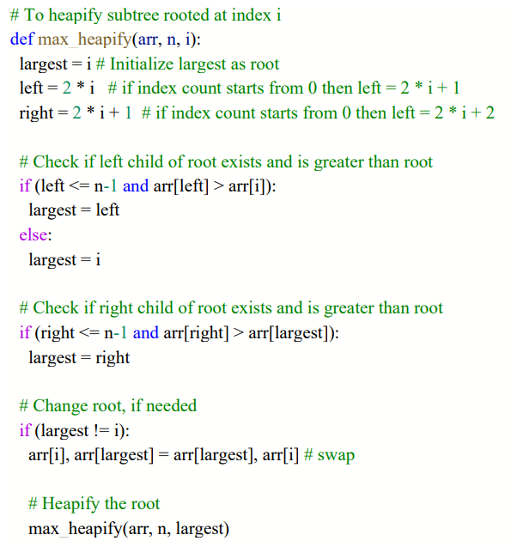
Heap Sort Algorithm Implementation

Slide 63
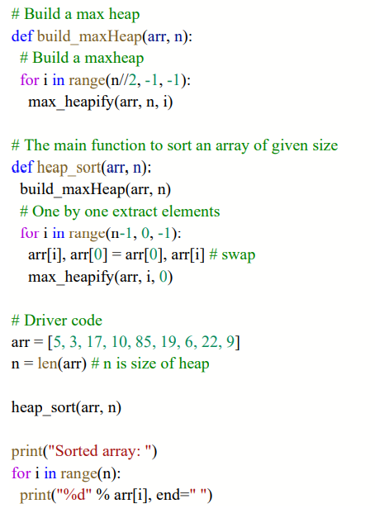
Heap Sort Algorithm Implementation Continued

Slide 64
Running Time of Max Heapify
The running time of max_heapify on a subtree of size n rooted at a given node i is the Θ(1) time to fix up the relationships among the elements A[i], A[Left(i)] and A[Right(i)] plus the time to run MAX-HEAPIFY on a subtree rooted at one of the children of node i (assuming that the recursive call occurs). The children’s subtrees each have size at most 2n/3 and the worst case occurs when the bottom level of the tree is exactly half full and therefore we can describe the running time of max_heapify by the recurrence,
T(n) ≤ T(2n/3) + Θ(1)
Notes:
Md. Asif Bin Khaled, Running Time of Max Heapify, https://docs.google.com/presentation/d/1ZGiEK5zT_0vbUznwuQEos70I2EKArLgK/edit#slide=id.p15

Slide 65
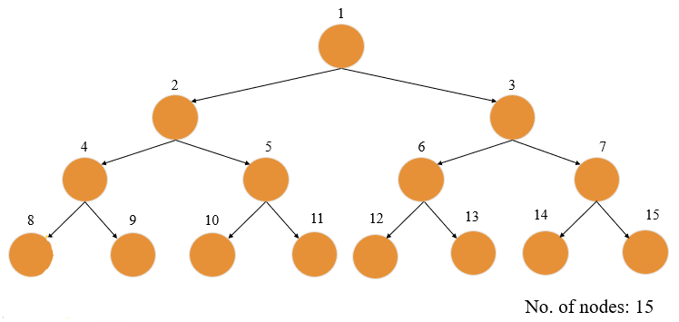
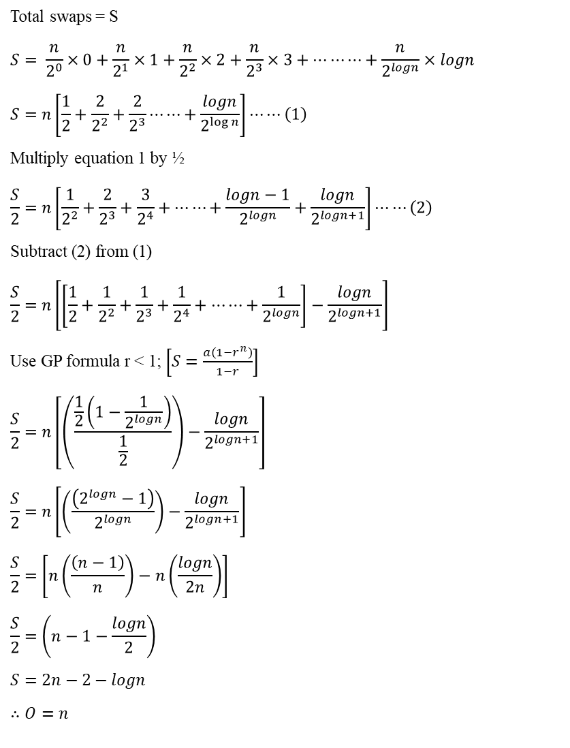

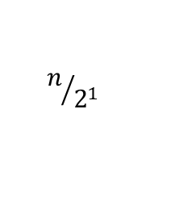
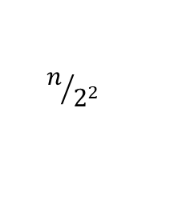
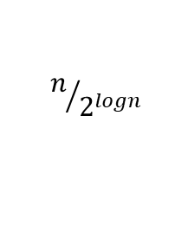
Complexity Analysis of Max Heapify
Total swaps = S
$$S= \frac{n}{2^{0}}×0+\frac{n}{2^{1}}×1+\frac{n}{2^{2}}×2+\frac{n}{2^{3}}×3+…⋯⋯+\frac{n}{2^{logn}}×logn$$
$$S=n\left[\frac{1}{2}+\frac{2}{2^{2}}+\frac{2}{2^{3}}⋯⋯+\frac{logn}{2^{\log{n}}}\right]⋯⋯\left(1\right)$$
Multiply equation 1 by ½
$$\frac{S}{2}=n\left[\frac{1}{2^{2}}+\frac{2}{2^{3}}+\frac{3}{2^{4}}+⋯⋯+\frac{logn−1}{2^{logn}}+\frac{logn}{2^{logn+1}}\right]⋯⋯\left(2\right)$$
Subtract (2) from (1)
$$\frac{S}{2}=n\left[\left[\frac{1}{2}+\frac{1}{2^{2}}+\frac{1}{2^{3}}+\frac{1}{2^{4}}+⋯⋯+\frac{1}{2^{logn}}\right]−\frac{logn}{2^{logn+1}}\right]$$
Use GP formula r < 1; $\left[S=\frac{a\left(1−r^{n}\right)}{1−r}\right]$
$$\frac{S}{2}=n\left[\left(\frac{\frac{1}{2}\left(1−\frac{1}{2^{logn}}\right)}{\frac{1}{2}}\right)−\frac{logn}{2^{logn+1}}\right]$$
$$\frac{S}{2}=n\left[\left(\frac{\left(2^{logn}−1\right)}{2^{logn}}\right)−\frac{logn}{2^{logn+1}}\right]$$
$$\frac{S}{2}=\left[n\left(\frac{\left(n−1\right)}{n}\right)−n\left(\frac{logn}{2n}\right)\right]$$
$$\frac{S}{2}=\left(n−1−\frac{logn}{2}\right)$$
$$S=2n−2−logn$$
$$∴O=n$$
$$n/{2^{logn}}$$
$$n/{2^{2}}$$
$$n/{2^{1}}$$
$$n$$
Notes:
Varun Singla, 10 March 2021, Complexity Analysis of Max Heapify, https://youtu.be/8noP3YjjJCM

Slide 66
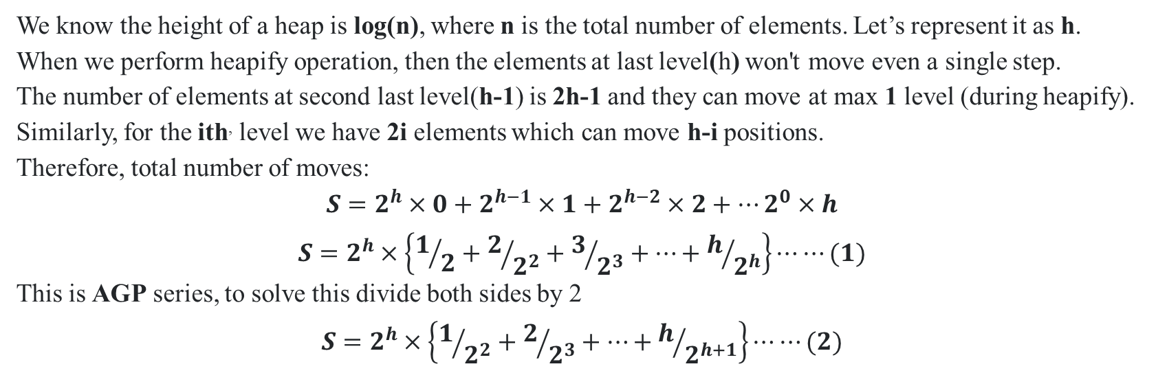
Complexity Analysis of Build Max Heap
We know the height of a heap is log(n), where n is the total number of elements. Let’s represent it as h. When we perform heapify operation, then the elements at last level(h) won't move even a single step.
The number of elements at second last level(h-1) is 2h-1 and they can move at max 1 level (during heapify). Similarly, for the ith, level we have 2i elements which can move h-i positions.
Therefore, total number of moves:
$$S=2^{h}×0+2^{h−1}×1+2^{h−2}×2+…2^{0}×h$$
$$S=2^{h}×\left\{1/2+2/{2^{2}}+3/{2^{3}}+…+h/{2^{h}}\right\}⋯⋯(1)$$
This is AGP series, to solve this divide both sides by 2 $$S=2^{h}×\left\{1/{2^{2}}+2/{2^{3}}+…+h/{2^{h+1}}\right\}⋯⋯(2)$$
Notes:
Tanuj Yadav, 25 November 2021, Complexity Analysis of Build Max Heap, https://stackoverflow.com/questions/9755721/how-can-building-a-heap-be-on-time-complexity

Slide 67
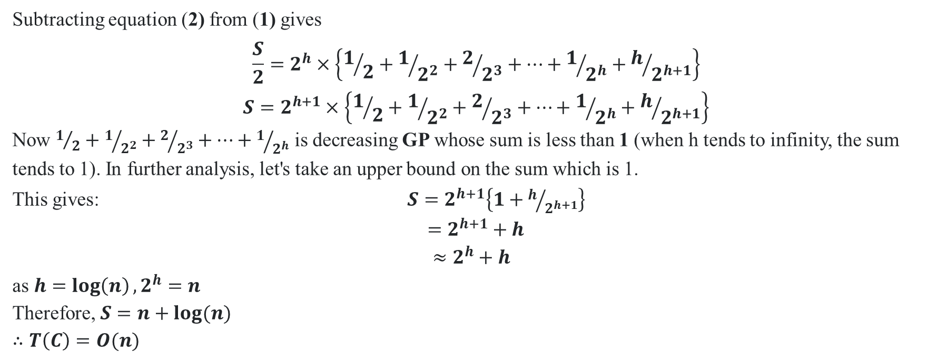
Complexity Analysis of Build Max Heap (Continued)
Subtracting equation (2) from (1) gives $$\frac{S}{2}=2^{h}×\left\{1/2+1/{2^{2}}+2/{2^{3}}+…+1/{2^{h}}+h/{2^{h+1}}\right\}$$
$$S=2^{h+1}×\left\{1/2+1/{2^{2}}+2/{2^{3}}+…+1/{2^{h}}+h/{2^{h+1}}\right\}$$
Now $1/2+1/{2^{2}}+2/{2^{3}}+…+1/{2^{h}}$ is decreasing GP whose sum is less than 1 (when h tends to infinity, the sum tends to 1). In further analysis, let's take an upper bound on the sum which is 1.
This gives: $S=2^{h+1}\left\{1+h/{2^{h+1}}\right\}$
$$=2^{h+1}+h$$
$$≈2^{h}+h$$
as $h=\log\left(n\right), 2^{h}=n$
Therefore, $S=n+log⁡(n)$
$$∴T\left(C\right)=O(n)$$
Notes:
Tanuj Yadav, 25 November 2021, Complexity Analysis of Build Max Heap, https://stackoverflow.com/questions/9755721/how-can-building-a-heap-be-on-time-complexity

Slide 68
Attributes of Heap Sort Algorithm
Stable or Unstable: Heap sort is unstable because operations in the heap can change the relative order of equivalent keys. The binary heap can be represented using array-based methods to reduce space and memory usage. This sorting algorithm can be made stable.
In-place or Out-of-place: Heap sort is an in-place algorithm, where inputs are overwritten using no extra data structures at runtime.
Online or Offline: Heapsort will first take the entire array and convert it into a max heap or min heap, so its an offline algorithm.
Adaptive or In-adaptive: A in-adaptive algorithm is one which does not consider the elements which are already sorted. They try to force every single element to be re-ordered to confirm their sorted-ness. Heap sort algorithm follow this attribute.
Notes:
14 August 2021, Attributes of Heap Sort Algorithm (1-2), https://faq-qa.com/en/Q%26A/page=acba121039cd44fde0bbbc1887a9d268
Ishita Gambhir, 21 July 2020, Attributes of Heap Sort Algorithm (3), https://discuss.codingblocks.com/t/heap-sort-issue/96524/4
Attributes of Heap Sort Algorithm (4), https://www.tutorialspoint.com/data_structures_algorithms/sorting_algorithms.htm

Slide 69
Attributes of Heap Sort Algorithm (Continued)
Comparison based or Non-comparison based: In a comparison based sorting algorithms, we compare elements of an array with each other to determines which of two elements should occur first in the final sorted list. Heap sort is a comparison based algorithm.
Positive and Negative Integer Number: Heap sort can work with both positive and negative integer number.
Positive and Negative Floating-point Number: Heap sort can work with both positive and negative floating-point number.
Notes:
Admin AfterAcademy, 25 December 2019, Attributes of Heap Sort Algorithm (Continued) (5), https://afteracademy.com/blog/comparison-of-sorting-algorithms

Slide 70
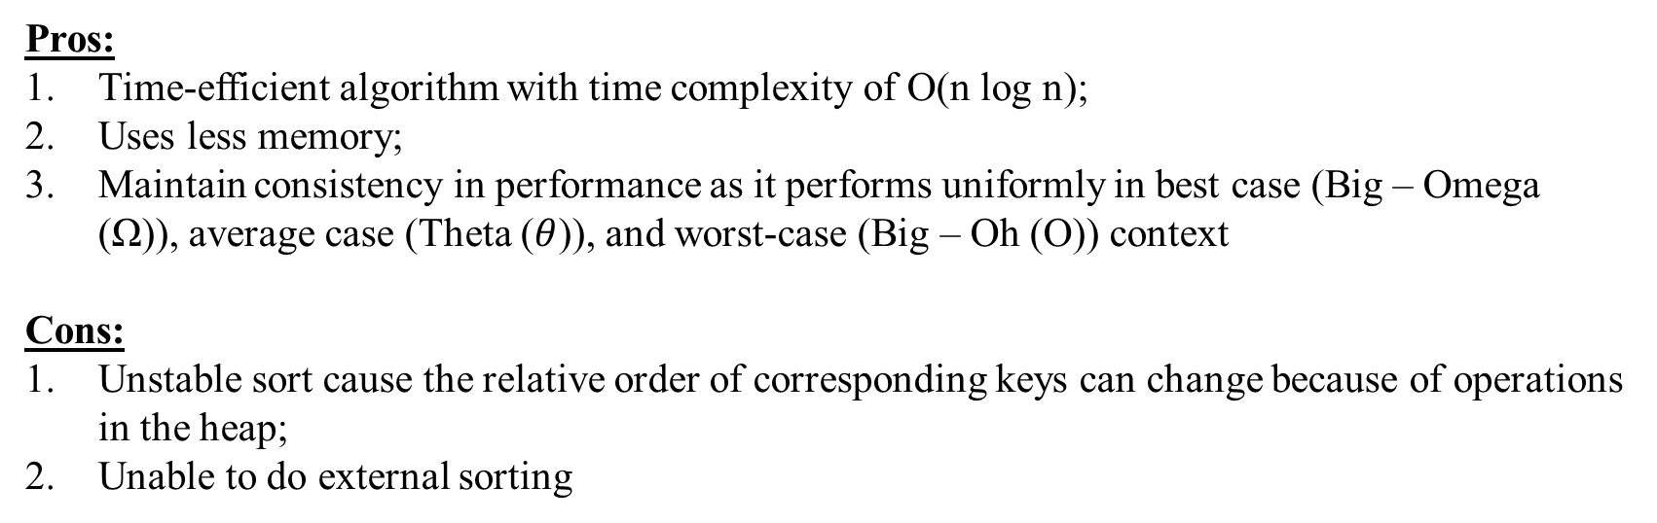
Pros and Cons of Heap Sort Algorithm
Pros:
Time-efficient algorithm with time complexity of O(n log n);
Uses less memory;
Maintain consistency in performance as it performs uniformly in best case (Big – Omega (Ω)), average case (Theta ($θ$)), and worst-case (Big – Oh (O)) context
Cons:
Unstable sort cause the relative order of corresponding keys can change because of operations in the heap;
Unable to do external sorting

Slide 71
Practical Uses of Heap Sort Algorithm
Systems concerned with security and embedded system such as Linux Kernel uses Heap Sort because of the O(nlog(n));
Able to access minimum or maximum value instantly;
Finding the order in statistics;
Dealing with priority queues in Dijkstra’s algorithm (shortest path), Prim’s algorithm (minimum spanning tree) and Huffman encoding (data compression);
In order to overcome the worst-case complexity of Quick Sort algorithm from O(n^2) to O(nlog(n)) in Heap Sort.

Slide 72
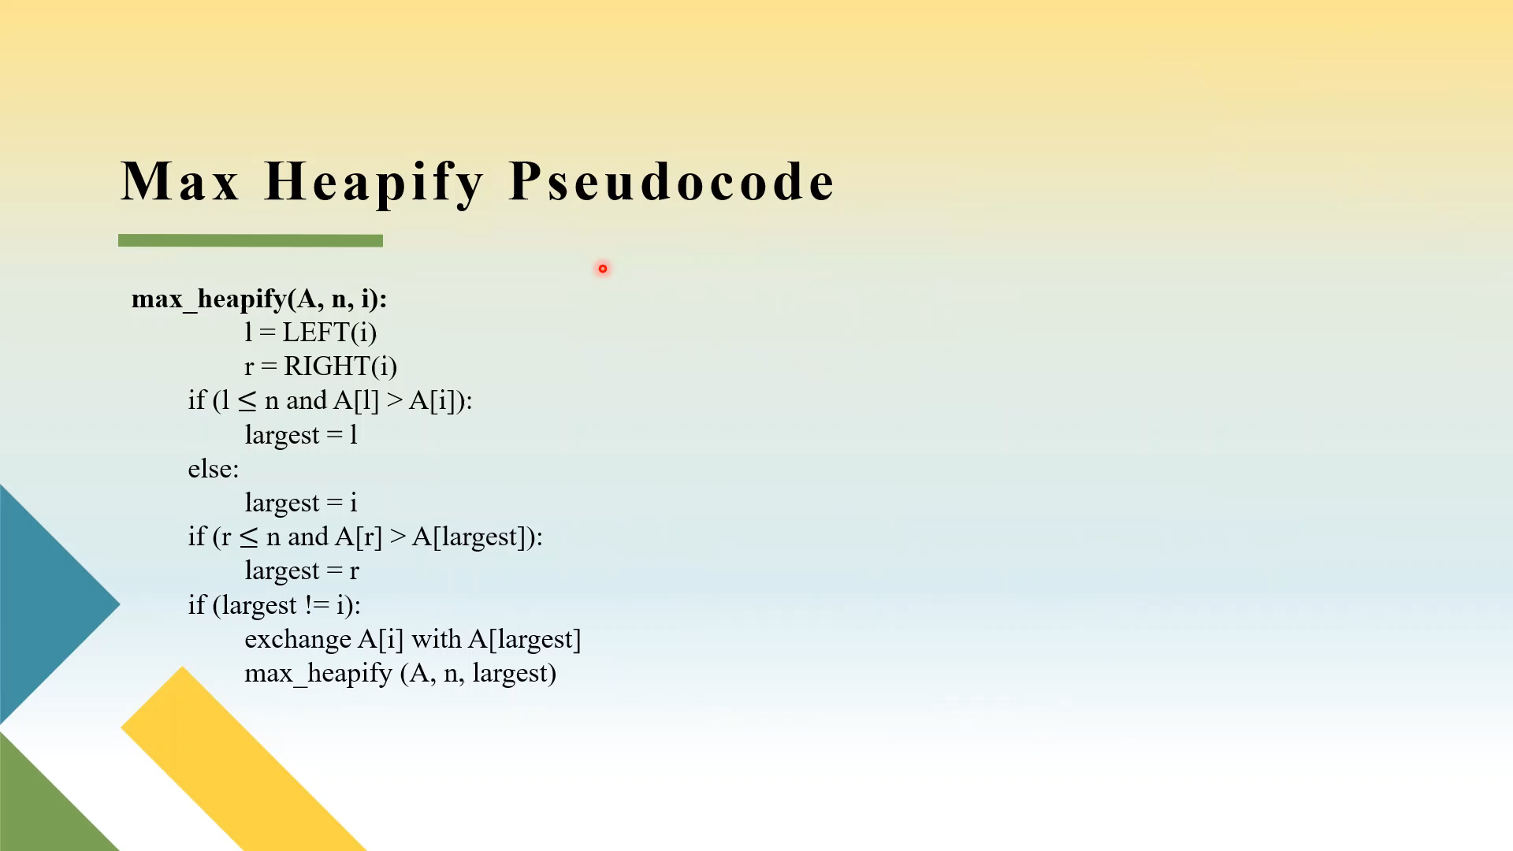
Heap Sort Pseudo Code Explanation

Slide 73
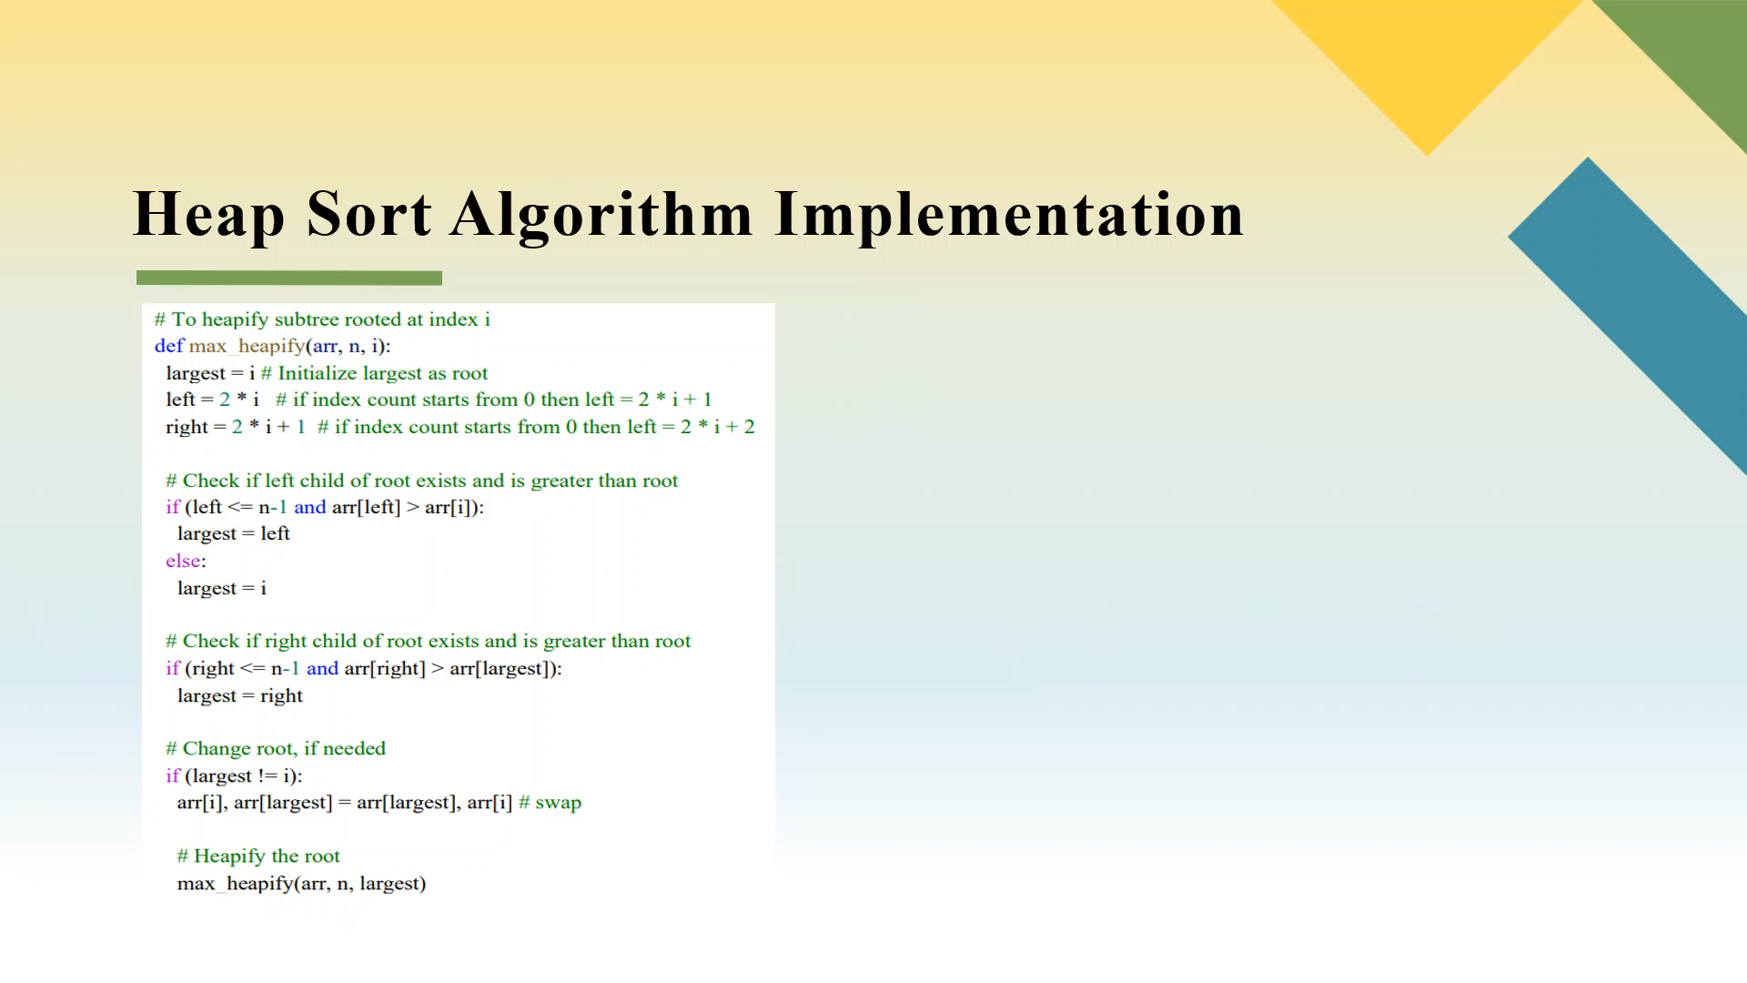
Heap Sort Algorithm Implementation Explanation

Slide 74
References
Md. Asif Bin Khaled, Maintaining the Heap Property, https://docs.google.com/presentation/d/1ZGiEK5zT_0vbUznwuQEos70I2EKArLgK/edit#slide=id.p8
Md. Asif Bin Khaled, Max Heapify Pseudocode, https://docs.google.com/presentation/d/1ZGiEK5zT_0vbUznwuQEos70I2EKArLgK/edit#slide=id.p9
Md. Asif Bin Khaled, Building a Heap, https://docs.google.com/presentation/d/1ZGiEK5zT_0vbUznwuQEos70I2EKArLgK/edit#slide=id.p18
Md. Asif Bin Khaled, Building Max Heap Pseudocode, https://docs.google.com/presentation/d/1ZGiEK5zT_0vbUznwuQEos70I2EKArLgK/edit#slide=id.p19
Md. Asif Bin Khaled, Building Max Heap Pseudocode, https://docs.google.com/presentation/d/1ZGiEK5zT_0vbUznwuQEos70I2EKArLgK/edit#slide=id.p47

Slide 75
References
Md. Asif Bin Khaled, Heap Sort Pseudocode, https://docs.google.com/presentation/d/1ZGiEK5zT_0vbUznwuQEos70I2EKArLgK/edit#slide=id.p48
Md. Asif Bin Khaled, Running Time of Max Heapify, https://docs.google.com/presentation/d/1ZGiEK5zT_0vbUznwuQEos70I2EKArLgK/edit#slide=id.p15
Varun Singla, 10 March 2021, Complexity Analysis of Max Heapify, https://youtu.be/8noP3YjjJCM
Tanuj Yadav, 25 November 2021, Complexity Analysis of Build Max Heap, https://stackoverflow.com/questions/9755721/how-can-building-a-heap-be-on-time-complexity
14 August 2021, Attributes of Heap Sort Algorithm (1-2), https://faq-qa.com/en/Q%26A/page=acba121039cd44fde0bbbc1887a9d268

Slide 76
References
Ishita Gambhir, 21 July 2020, Attributes of Heap Sort Algorithm (3), https://discuss.codingblocks.com/t/heap-sort-issue/96524/4
Attributes of Heap Sort Algorithm (4), https://www.tutorialspoint.com/data_structures_algorithms/sorting_algorithms.htm
Admin AfterAcademy, 25 December 2019, Attributes of Heap Sort Algorithm (Continued) (5), https://afteracademy.com/blog/comparison-of-sorting-algorithms
https://algorithm-visualizer.org/brute-force/heapsort

Slide 77
Thank You!

